Slide 1
Processes
What is a process?
Structure of a process.
Process state.
Schedulers and Scheduling Queues.
Context switching.
Process creation and termination.
Inter Process Communication.
Dr. Manmath N. Sahoo
Dept. of CSE, NIT Rourkela

Slide 2
Process
Process is a program that has initiated its execution.
A program is a passive entity; whereas a process is an active entity.

Slide 3
Process structure
A process includes:
program section - contains a copy of the machine code instructions
user data section - to hold variable data values
system data section - to hold
process context info when process interrupted - program counter, processor registers, etc and
system information about resources allocated to process, etc.
user and system data sections obviously may be different from one run of a process to another

Slide 4
Process State
As a process executes, it changes state.
new: The process is created by OS
ready: The process is waiting to be assigned to a processor.
running: Instructions are being executed on processor
waiting: The process is waiting for some event to occur
terminated: The process has finished execution.

Slide 5
Process Control Block (PCB)
PCB - data structure that contains Information associated with each process:
Process ID
Process State
Program Counter
Register Contents
Starting address of the process
Size of the process
Pointer to Child Process
Pointer to Next PCB (Sibling Pointer)
Resource Pointer

Slide 6
Process Scheduling Queues
Job queue – Set of all processes just created by LTS (new state processes).
Ready queue – set of all processes that are in main memory, ready to execute (ready state processes).
Device queues – set of processes waiting to use an I/O device (waiting state processes).

Slide 7
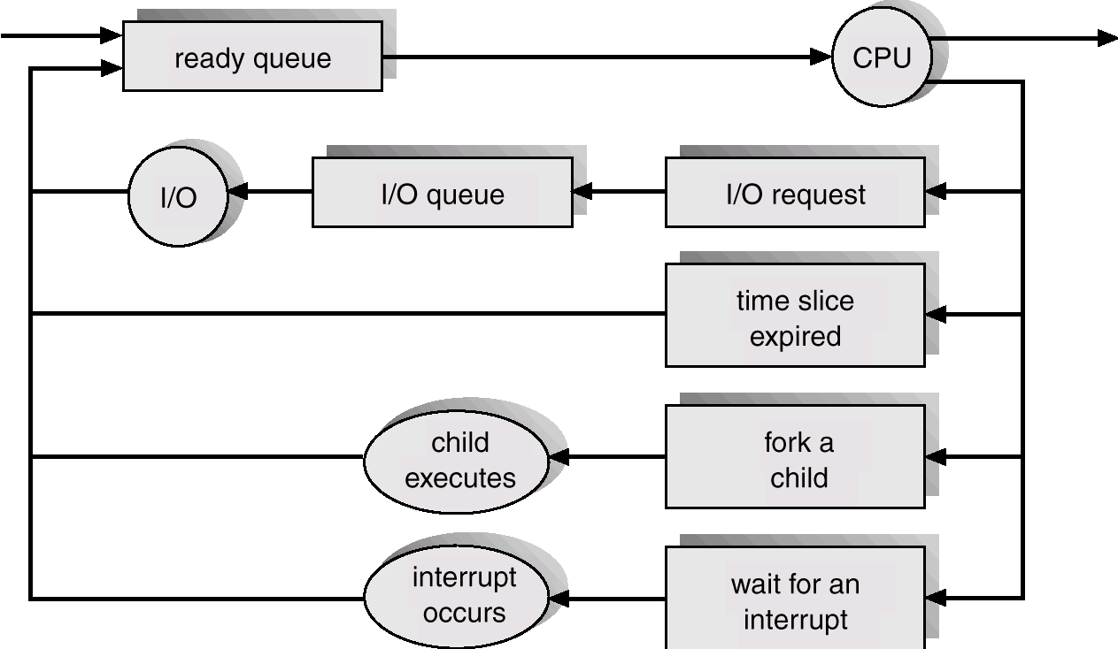
Queueing Diagram

Slide 8
Schedulers
Long-term scheduler (LTS) (or job scheduler) – selects which processes should be brought into the ready queue.
Short-term scheduler (STS) (or CPU scheduler) – selects which process should be executed next on CPU.

Slide 9
Schedulers
Short-term scheduler is invoked very frequently (milliseconds) -> (must be fast).
Long-term scheduler is invoked very infrequently (seconds, minutes) -> (may be slow).
The long-term scheduler controls the degree of multiprogramming - this is the number of processes in the system that can be scheduled onto the CPU I.e. number of processes competing for CPU as a resource.

Slide 10
Schedulers
Long-term schedule should choose a good process mix; otherwise it may lead to either low CPU utilization (if I/O bound processes are selected only) or low Device utilization (if CPU bound processes are selected only).
I/O-bound process – have small amount of computation before it needs to do some I/O; many I/O requests -Typical interactive user programs.
CPU-bound process – large amount of computation before it needs to do some I/O; few I/O requests - Programs that require sustained periods of calculation e.g. modelling applications

Slide 11
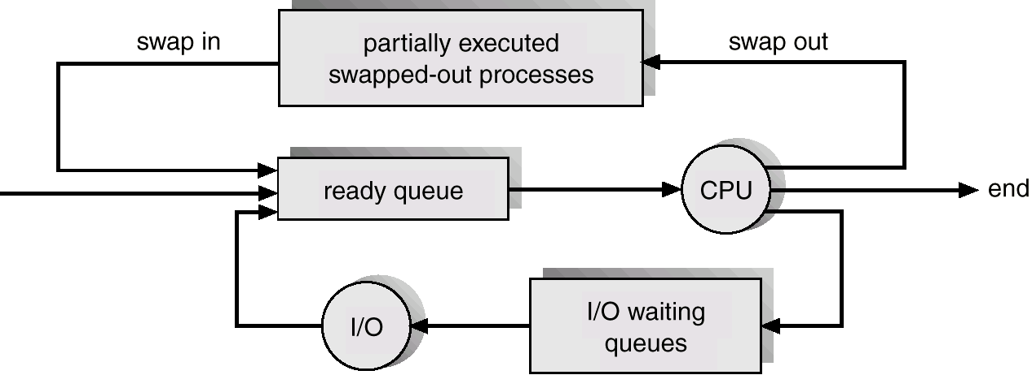
Schedulers
Some OS have a light LTS; and a Medium Term Scheduler (MTS).
If degree of multiprogramming becomes high then total context switch overhead will be more.
MTS can temporarily swap some processes out to disk and bring them back later.

Slide 12
Context Switch
When CPU switches to another process, the system must save the state of the old process and load the saved state for the new process.
Context-switch time is overhead; the system does no useful work while switching.

Slide 13
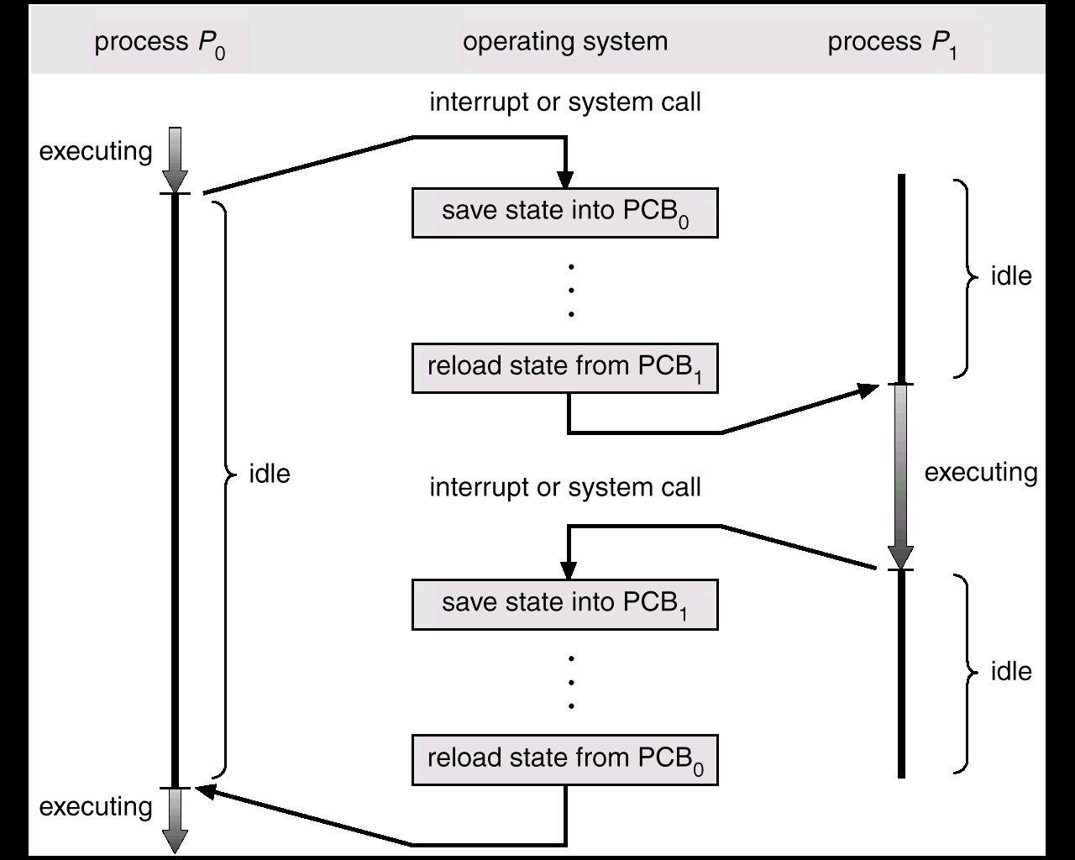
CPU switched between processes

Slide 14
Process Creation
When a process is created it is created by another process known as the parent process - new process created is the child process of the parent. New process may in turn create other processes, forming a family tree of processes.
There must be a first process (init process) - this is process that is created at bootup of the OS and is part of OS.

Slide 15
Process Creation (Cont.)
Resource sharing between parent and child processes - options include:
Parent and children share all resources, or
Children share subset of parent’s resources, or
Parent and child share no resources.
Execution options:
Parent and children execute concurrently, or
Parent waits until children terminate.

Slide 16
Process Termination
Process executes last statement and asks the operating system to delete it (exit system call). Then
Return data from child to parent.
Process’ resources are deallocated by operating system.
Parent may terminate execution of children processes (abort). Reasons for this could be:
Task assigned to child is no longer required.
Parent is exiting and O/S does not allow children to continue if their parent terminates – cascaded termination.

Slide 17
Cooperating Processes
Process is independent if it cannot legally affect or be affected by the execution of another process.
Process is cooperating if it can legally affect or be affected by the execution of another process.

Slide 18
Why Cooperating Processes?
Processes may need to share data
More than one process reading/writing the same data (a shared file, a database record,…)
Output of one process being used by another
Ordering executions of multiple processes may be needed to ensure correctness
Process X should not do something before process Y does something etc.
Need mechanisms to pass control signals between processes
Modularity - dividing system functions into separate processes that then talk to each other
Computation speed-up - but only if >1 processor

Slide 19
Inter-Process Communication (IPC)
Fundamental types of IPC
Message passing
P and Q exchange messages
Shared memory
P writes into a shared location, Q reads from it and vice-versa

Slide 20
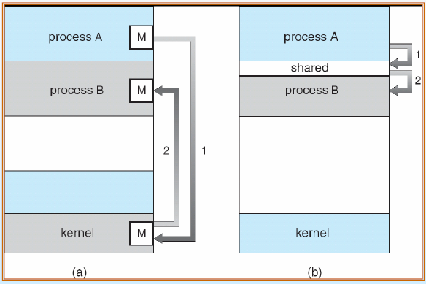
Inter-Process Communication (IPC)
(a) Message Passing (b) Shared Memory

Slide 21
Message Passing System

Slide 22
Message Passing System
Direct vs. Indirect
Symmetric vs. Asymmetric
Synchronous vs. Asynchronous

Slide 23
Message Passing System: Direct
Primitives:
Connect (sender address, receiver address), for connection-oriented communication.
Send ( [receiver], message) e.g., Send(P, msg)
Receive ( [sender], message storage object) e.g., Receive(Q,msg)
Disconnect (connection identifier), for connection-oriented communication.

Slide 24
Message Passing System: Direct
Symmetric – Both the sender and receiver have to explicitly name each other.
Asymmetric – Only the sender has to name the receiver, but the receiver doesn’t need to name the sender.
Facilitates many-to-one communication.
Send(P,msg); - send message to P.
Receive(id,msg); - receive message from any process. “id” will be set to the name of the process with which communication has taken place.

Slide 25
Message Passing System: Indirect
The messages are sent and received to/from mailboxes.
Each mailbox has a unique identifier.
Two processes can communicate with each other iff they have a shared mailbox.

Slide 26
Message Passing System: Synchronous Vs. Asynchronous
Synchronous – After initiating a send/receive operation, the process waits for the acknowledgement (the process is blocked)
Asynchronous – After initiating a send/receive operation, the process continues its execution

Slide 27
Synchronous send and receive

Slide 28
Asynchronous send and synchronous receive

Slide 29
Synchronous send and Async. Receive - A

Slide 30
Synchronous send and Async. Receive - B

Slide 31
Synchronous send and Async. Receive - C

Slide 32
Asynchronous send and Asynchronous receive - C
non

Slide 33
Event diagram

Slide 34
Blocking, deadlock, and timeouts
Blocking operations issued in the wrong sequence can cause deadlocks.
Deadlocks should be avoided. Alternatively, timeout can be used to detect deadlocks.

Slide 35
Using threads for asynchronous IPC
If only blocking operation is provided for send and/or receive, then it is the programmer’s responsibility to using child processes or threads if asynchronous operations are desired.

Slide 36
Buffering during message passing
Zero capacity
No waiting queue/buffer
Sender must wait for receiver, after generating one item
Bounded capacity
Buffer has a fixed length N.
Unbounded capacity
No practical limit on the size of the buffer

Slide 37
Process: Exception Conditions
Process Termination
Sender Terminates: If the receiver has initiated a blocking receive then the OS either terminates the receiver or notifies it that Sender has terminated.
Receiver Terminates: If the sender has initiated a blocking send then the OS either terminates the Sender or notifies it that Receiver has terminated.
Lost Messages
The OS is responsible for detecting this event and for resending the message.
The Sender is responsible for detecting this event and for resending it.
The OS detects the event and notifies the Sender about it.
Scrambled Messages
Due to noise in the channel
Handled in the similar ways as lost messages.

